Slide 1
Life Transitions: Easing Into Parenthood
Team: #7
Team Name: The Seven
Team Members: Mehroos Ali, Soumadeep Basu, Mary Grace Kozuch, Sudarshan Athreya Suresh

Slide 2
POV 1
We met a mother in her mid 20’s who works part time as an occupational therapist and has a one year old son.
We were surprised to see that despite the plethora of information out there regarding health, sleep, nutrition etc. (Other parents, doctors, books etc.) parents are still not sure as to the reliability and effectiveness of these proposed solutions.
We wonder if this means that parents unsure of current sources and are looking for more reliable and specific information, whether it be about health, sleep cycles, nutrition etc.
It would be game changing to provide parents with tailored and specific information from reliable and professional sources.

Slide 3
POV 2
We met with a mother in her late 20’s to a 4-month old daughter who works part time as a Fellowship of Catholic University Students (FOCUS) mentor at the University of Texas Dallas.
We were surprised to notice that although parents can comprehend that raising children is expensive, they rarely plan or have the required tools to financially plan for raising children.
We wonder if this means that parents are more stressed than they need be because they are unaware of financial options and tools which would assist in raising a child and manage expenses.
It would be game-changing to provide easily accessible financial information to adults before they become parents.

Slide 4
POV 3
We met a 25 year old father to a 1 year old son who works as a Biomedical engineer remotely allowing him to be with his son all day long.
We were surprised to know that although parents are overjoyed and grateful about parenthood, they acknowledge that they had to sacrifice a lot of hobbies and passions which were important to them.
We wonder if this means, parents struggle to prioritize themselves and want to explore their passions after parenthood but do not have the time or means to do so.
It would be game-changing to provide ways to help them actively engage with their hobbies without affecting their duty as a parent.

Slide 5
POV 4
We met a mother in her mid 20’s who works part time as an occupational therapist and has a one year old son.
We were surprised to know that she feels a wide and complex range of emotions while dealing with children ( such as neglecting children while working, not being able to bond with the child etc. )
We wonder if it means, that she is stressed and anxious as a consequence of the ups and downs of raising a child.
It would be game-changing to provide mental health care to her from licensed and professional medical sources so that she can be the best versions of herself.

Slide 6
HMW 1:
Help mothers find quiet spaces/rooms/surroundings to feed and change babies.
Provide updated FAQs about allergies, home remedies, recipes etc. to parents
Provide schedules to manage child eating patterns.
Monitor sleep patterns and work towards healthier cycles for both themselves and the child ?
Track methods and remedies that worked for other parents, and give ways to post such informations themselves.
Give easy methods for parents to schedule consultations and appointments with doctors and specialists.
Provide common symptoms and alarms experienced by most babies. ( Bee Stings, Jaundice, Impared Speech / Vision etc.)
provide a platform so that parents can browse catalogues for tested and approved baby products(i.e. mattresses, bottles, pacifiers etc)
Help parents ask the right questions regarding their child's sleep and feeding patterns.
Educate parents about the importance of hygiene when handling a baby to prevent infections

Slide 7
HMW 2:
Give parents a list of govt and funded resources that can help them acquire emergency funds if needed.
Help parents find methods to reduce monthly expenditure based on their income and spending habits, by maintaining and enforcing a household budget.
Help parents predict financial risks based on their current spending and income.
Supply easily understandable insurance and tax form information. (Understand how tax returns and insurance claims work properly)
Provide popular and tested saving methods to new parents.
Help connect banks and parents so that they can save through college funds, health care, HSA etc.
Help parents access cheaper options by comparing rates from different sources for daily ongoing purchases such as medications, cribs, toys, insurance etc. Also, they can arrange items directly from other parents who do not need said item anymore.
Provide information about parental incentives provided by different companies, banks and programs.
Help parents who are looking for jobs or looking to switch jobs connect to the right employer.
Give better housing options to the new couple to better accommodate the baby.

Slide 8
HMW 3:
Create and display information for events so that parents can attend them ( Running clubs, book clubs etc.)
Help parents take out an hour or two a day so that they can dedicate time to their hobbies.
Provide means to parents to track daily goals( How many miles did you run, how many pages did you read) and give incentives to do the same.
Provide means to manage between productive and relaxing interests.
Give newborn and child friendly meeting places for parents who want to socialize.
Expose parents to new indoor and outdoor activities based on their interests.
Host online events and meetings for events for parents who have trouble leaving the house.
Host more events based on locality and rated interests which are logged by parents.
Give ratings for events based on safety, environment and enjoyability.
Connect parents to trusted and certified secondary care providers if they ever need to go out for work or personal reasons.

Slide 9
HMW 4:
Help parents attend group sessions and talks where they can discuss their issues and views with one another in a safe space.
Connect parents to licensed therapists to better understand themselves and the emotions that they are dealing with.
Provide parents with various ways to bond with their children. ( This is specific to cases where a parent feels that they are not as close as they want to be with a child).
Help parents strike a balance with their work life and the their parenthood.
Connect parents to a forum where they can read and seek comfort in the learnings and struggles of more experienced parents.
Get parents to feel more confident in their parenting
Find ways to bring personal accomplishments into a parents life
Give parents more opportunities to discuss how they are feeling
Support parents needs, physical and mental
Increase workplace assistance for parents

Slide 10
Best HMWs:
Provide updated FAQs about allergies, home remedies, recipes etc. to parents.
Help parents access cheaper options by comparing rates from different sources for daily ongoing purchases such as medications, cribs, toys, insurance etc. Also, they can arrange items directly from other parents who do not need said item anymore.
Provide means to parents to track daily goals and give incentives to do the same.
Connect parents to trusted and certified secondary care providers if they ever need to go out for work or personal reasons.
Notable Mentions:
Provide common symptoms and alarms experienced by most babies. ( Bee Stings, Jaundice, Impared Speech / Vision etc.)
Help parents predict financial risks based on their current spending and income.
Connect parents to licensed therapists to better understand themselves and the emotions that they are dealing with.

Slide 11
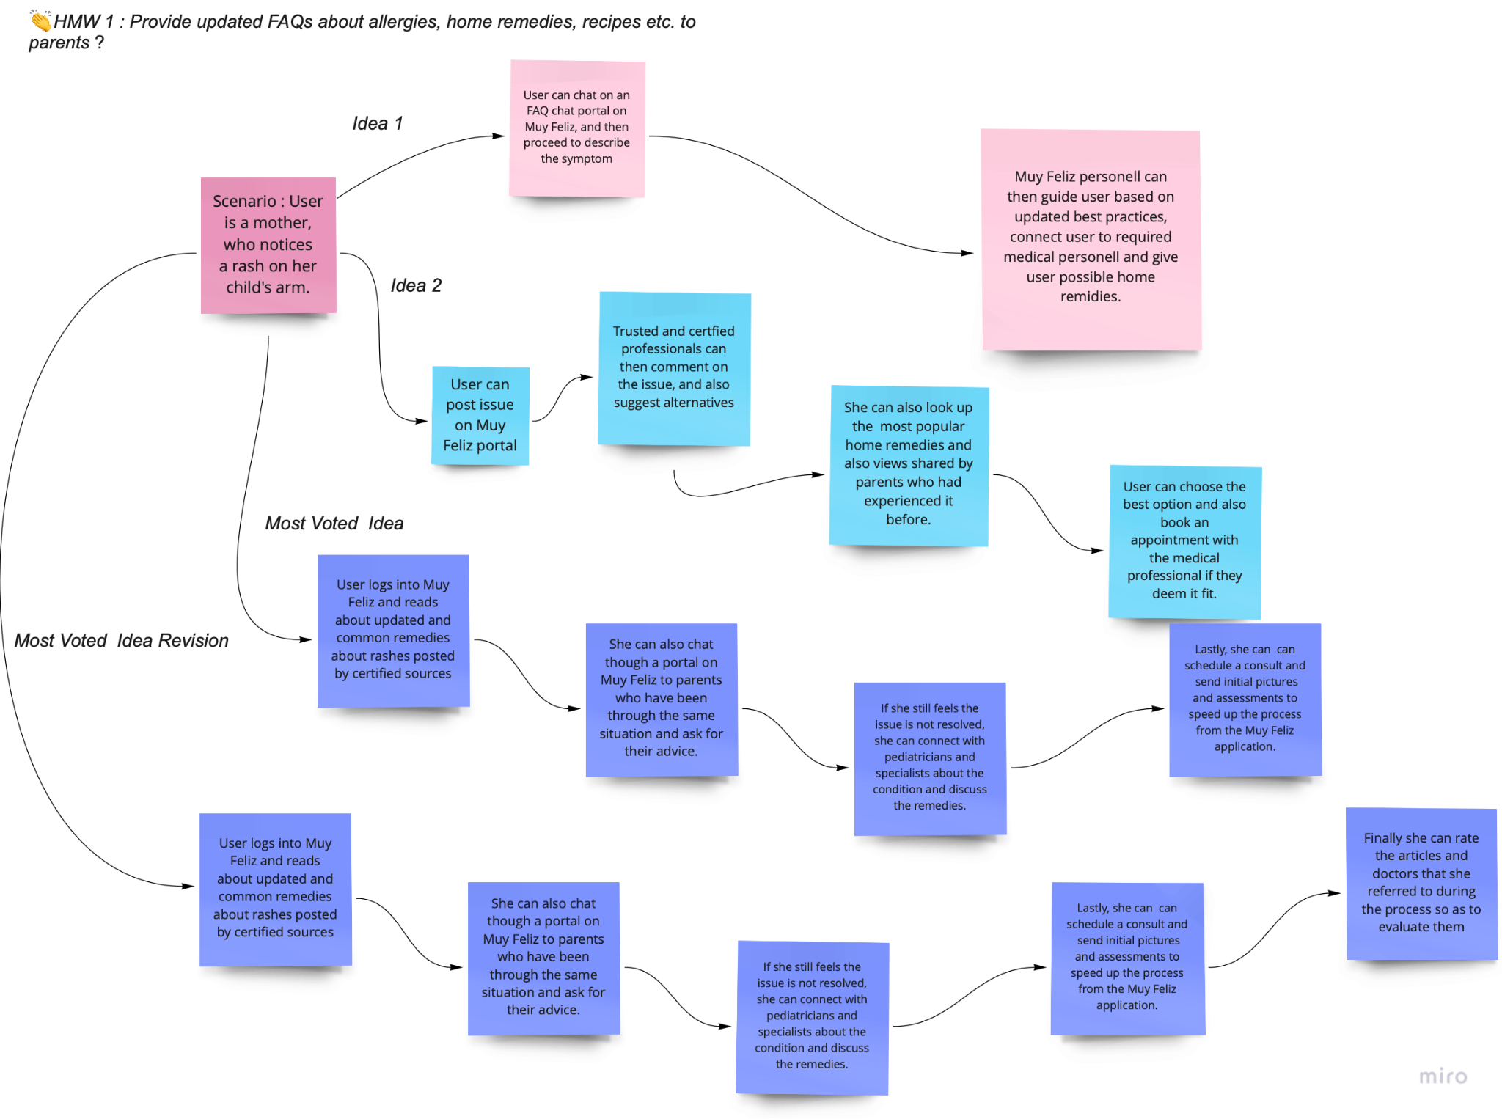
Brainstorming : Idea 1

Slide 12
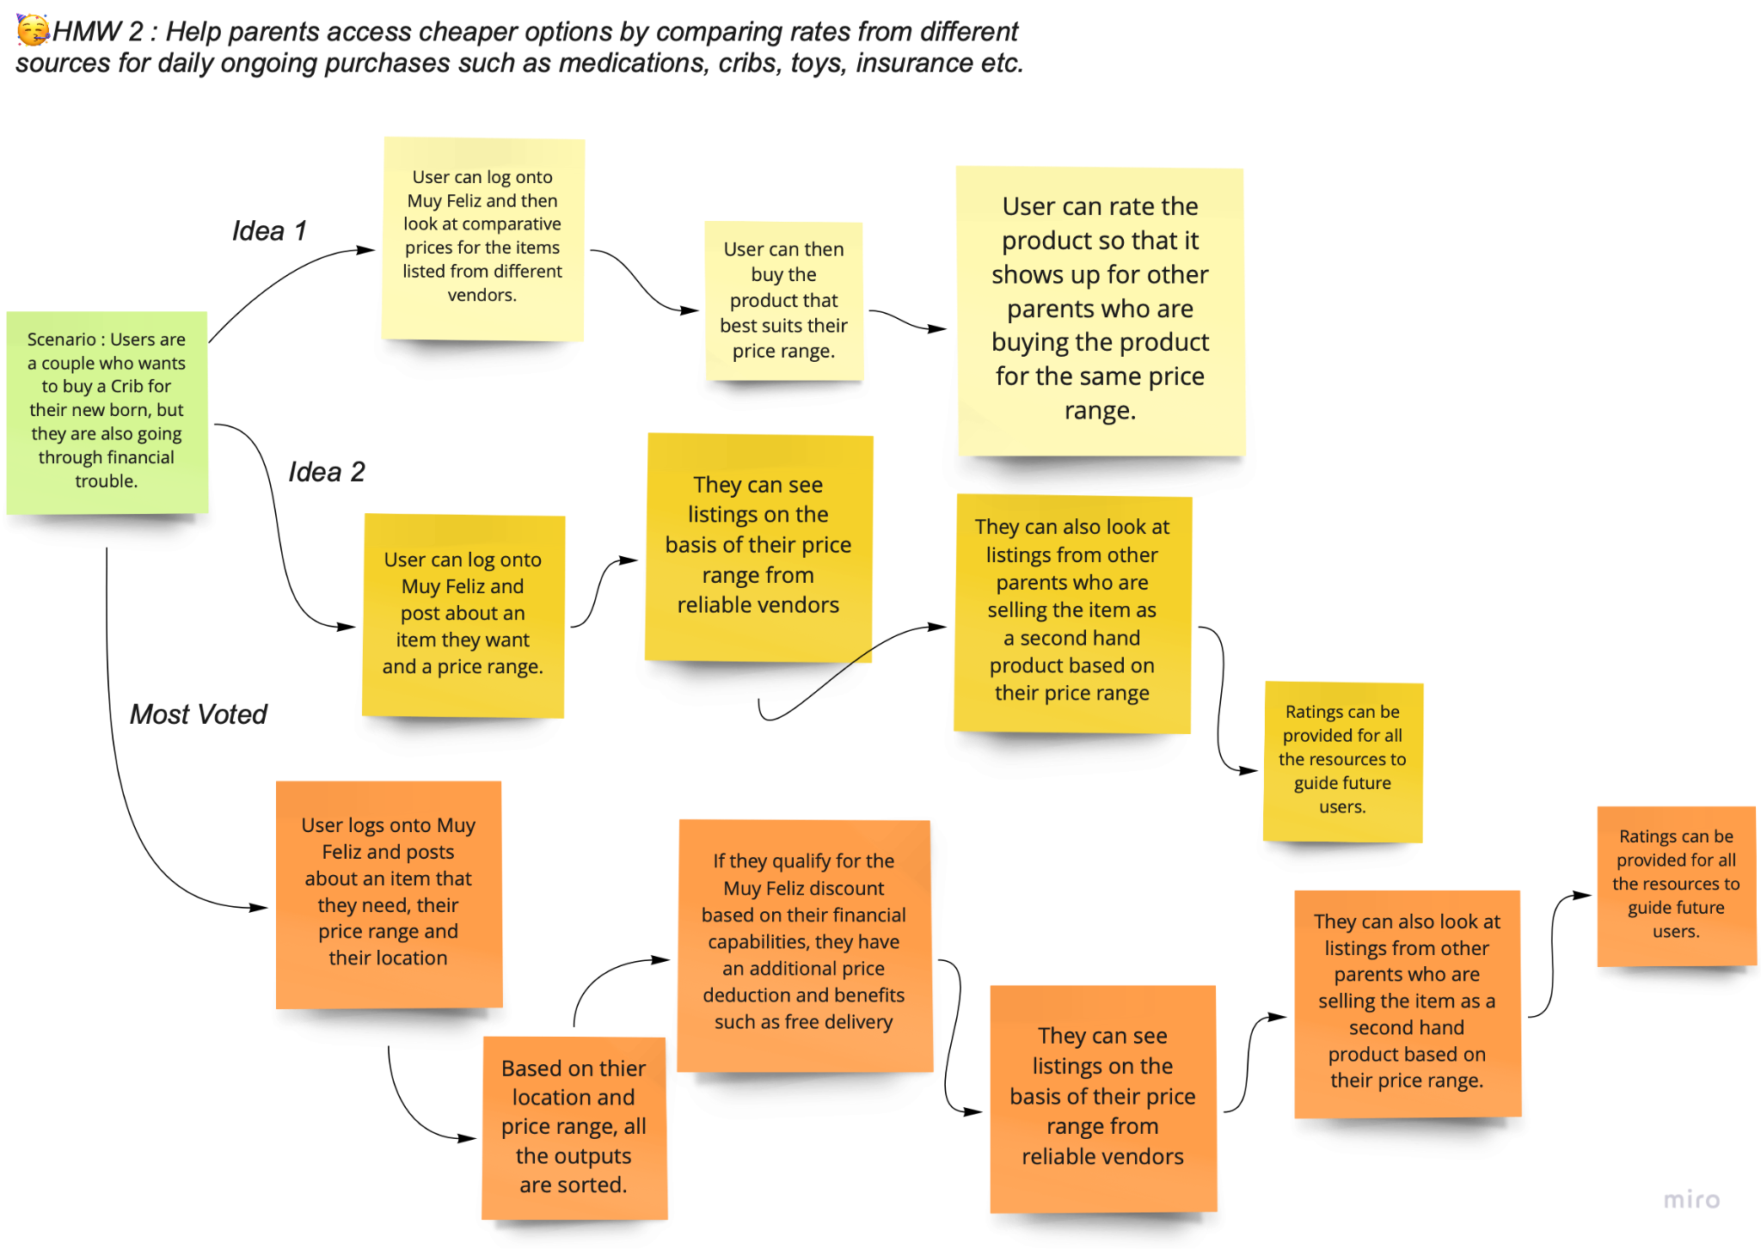
Brainstorming : Idea 2

Slide 13
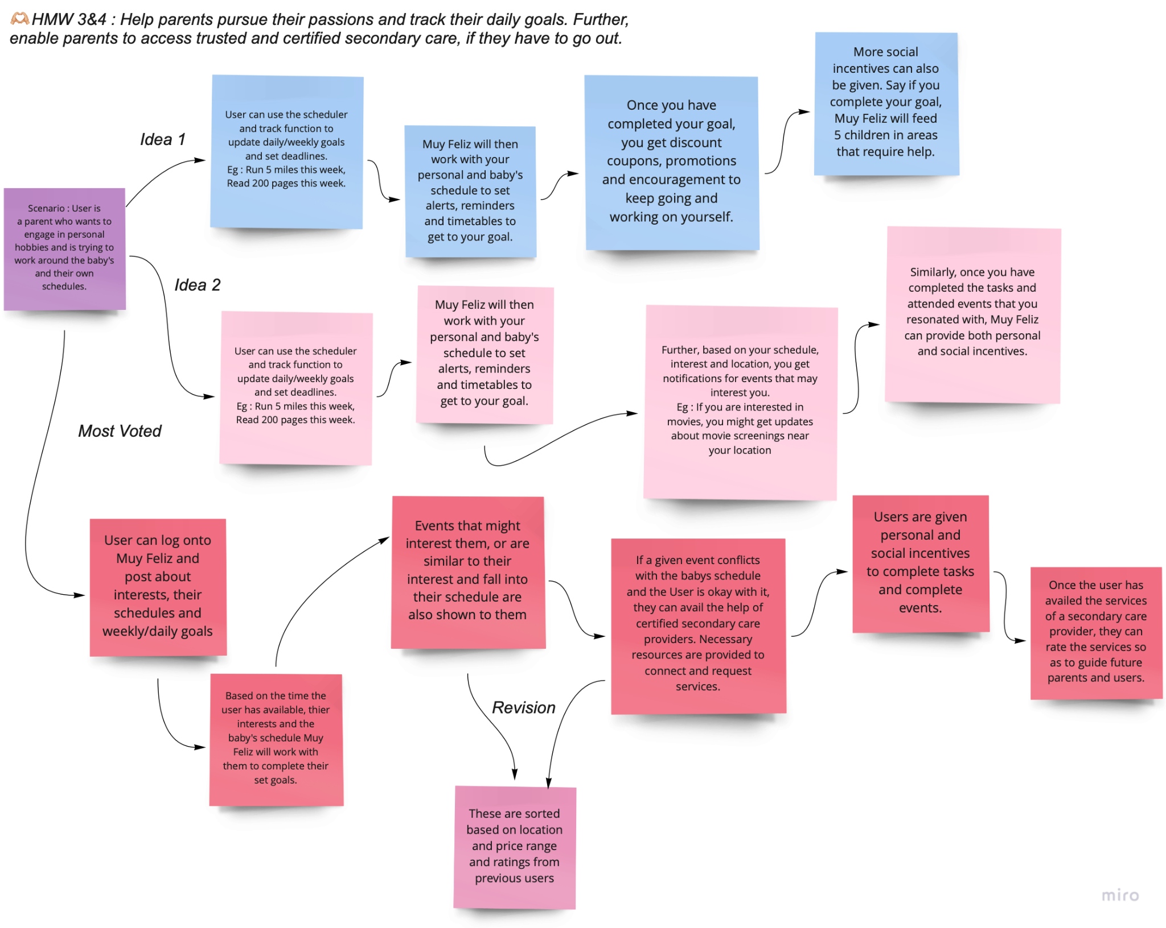
Brainstorming : Idea 3

Slide 14
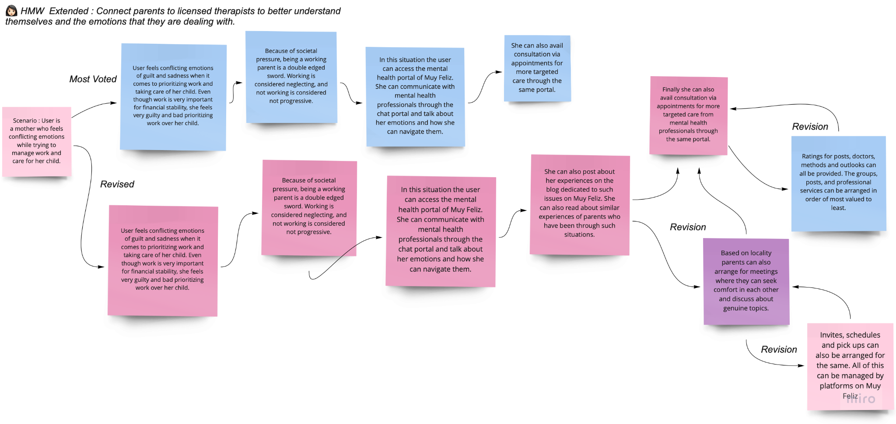
Brainstorming :
HMW extended

Slide 15
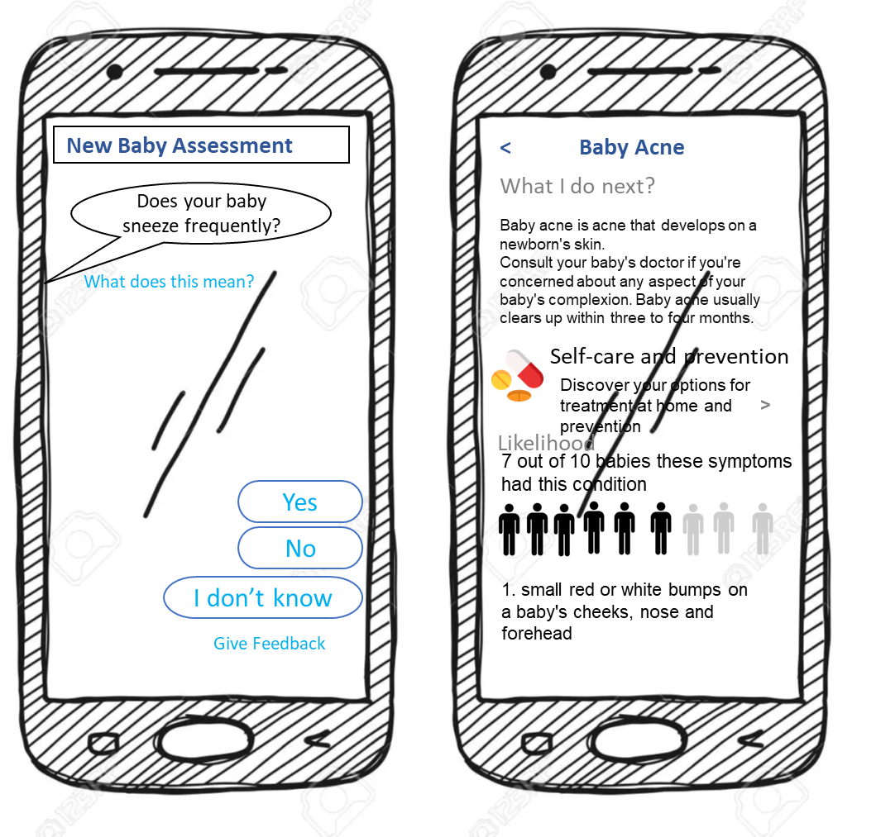
Solution Idea 1:
HMW provide updated FAQs about allergies, home remedies, recipes etc. to parents ?
Solution: Provide parents with access to easily searchable and understandable up to date medical information. Additionally, parents will have chat access with parents in similar situations or medical professionals with viewable ratings. After interacting with others on the app, users will have the option to give feedback and ratings on the professional with which they spoke. Shown ratings will be determined based on professional standing and user responses.

Slide 16
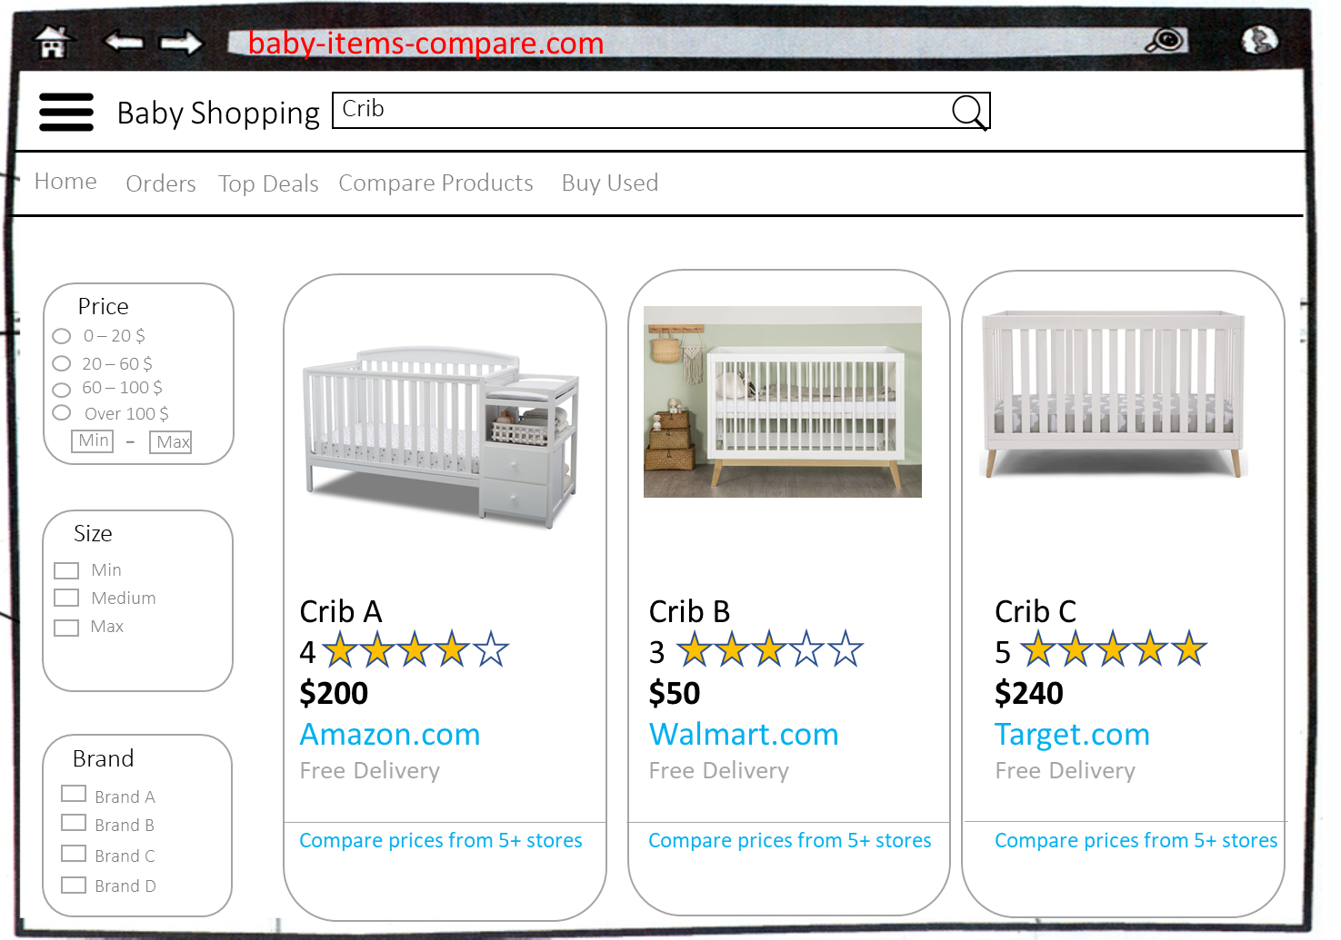
Solution Idea 2:
HMW help parents access cheaper options by comparing rates from different sources for purchases such as medications, cribs, toys, or insurance. Also, they can arrange items directly from other parents who do not need said item anymore.
Solution: Parents can choose different items with specific price ranges and get a variety of options which fit their criteria. They can also share ratings and feedback on items that they have bought. Additionally, items can be sold second hand through the platform to provide cheaper options to those in need. Parents may also apply for financial assistance through the platform and if qualified may receive discounts on necessary items.

Slide 17
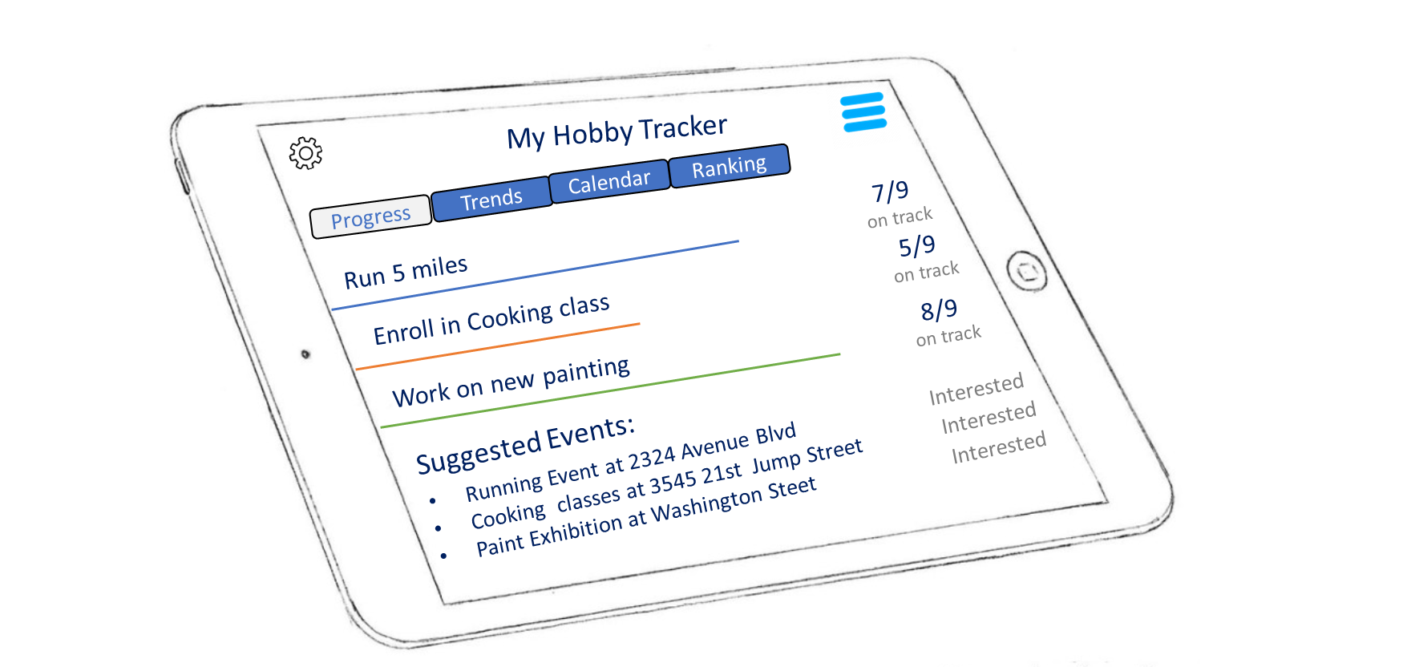
Solution Idea 3: (Best Solution)
HMW provide means for parents to track daily goals and give incentives to do the same.
Solution: Create a platform which allows parents to input their lifestyle goals such as exercise or hobbies as well as their necessary schedule and their babies schedule. The platform will create a schedule which allows the parent to accomplish as many of their goals as they would like while being flexible with the child’s schedule throughout the day and making the necessary updates as needed. The application will also give incentives to stay on track with personal goals to help prioritize the parent as well as the child.

Slide 18
Storyboard : HMW provide means for parents to track daily goals and give incentives to do the same. (Best Solution)

Slide 19
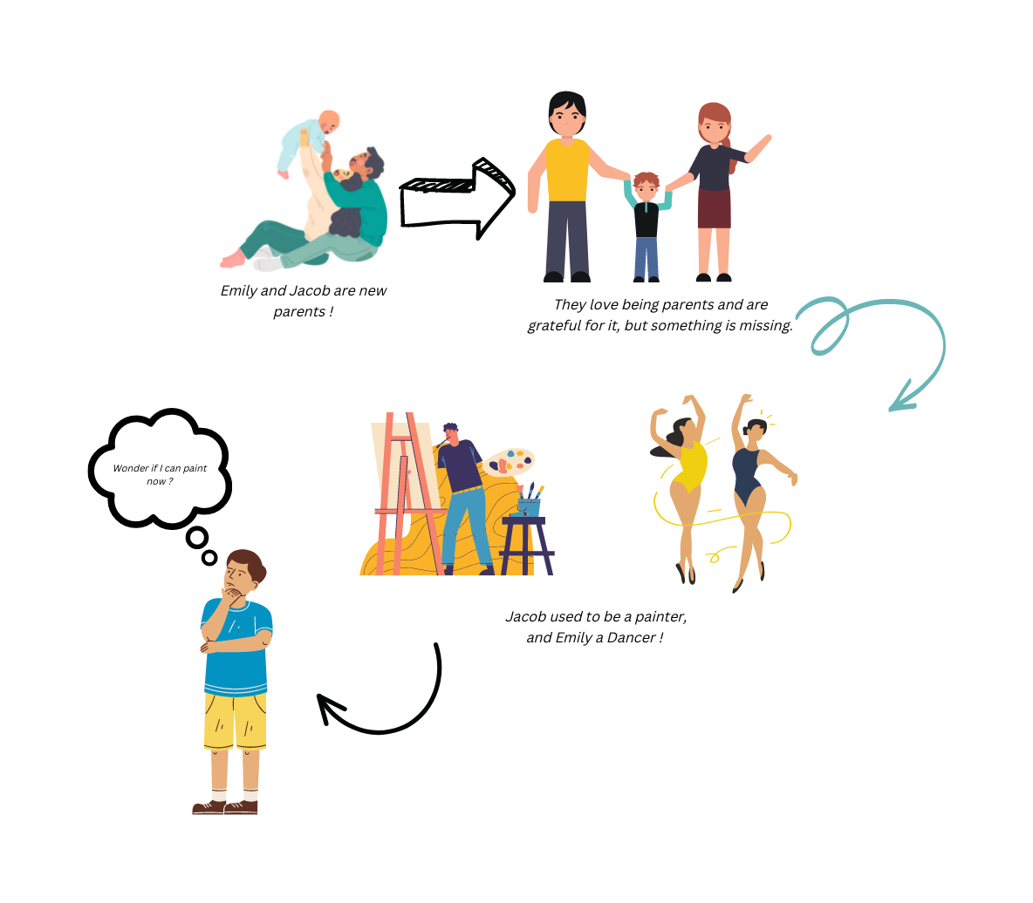

Slide 20
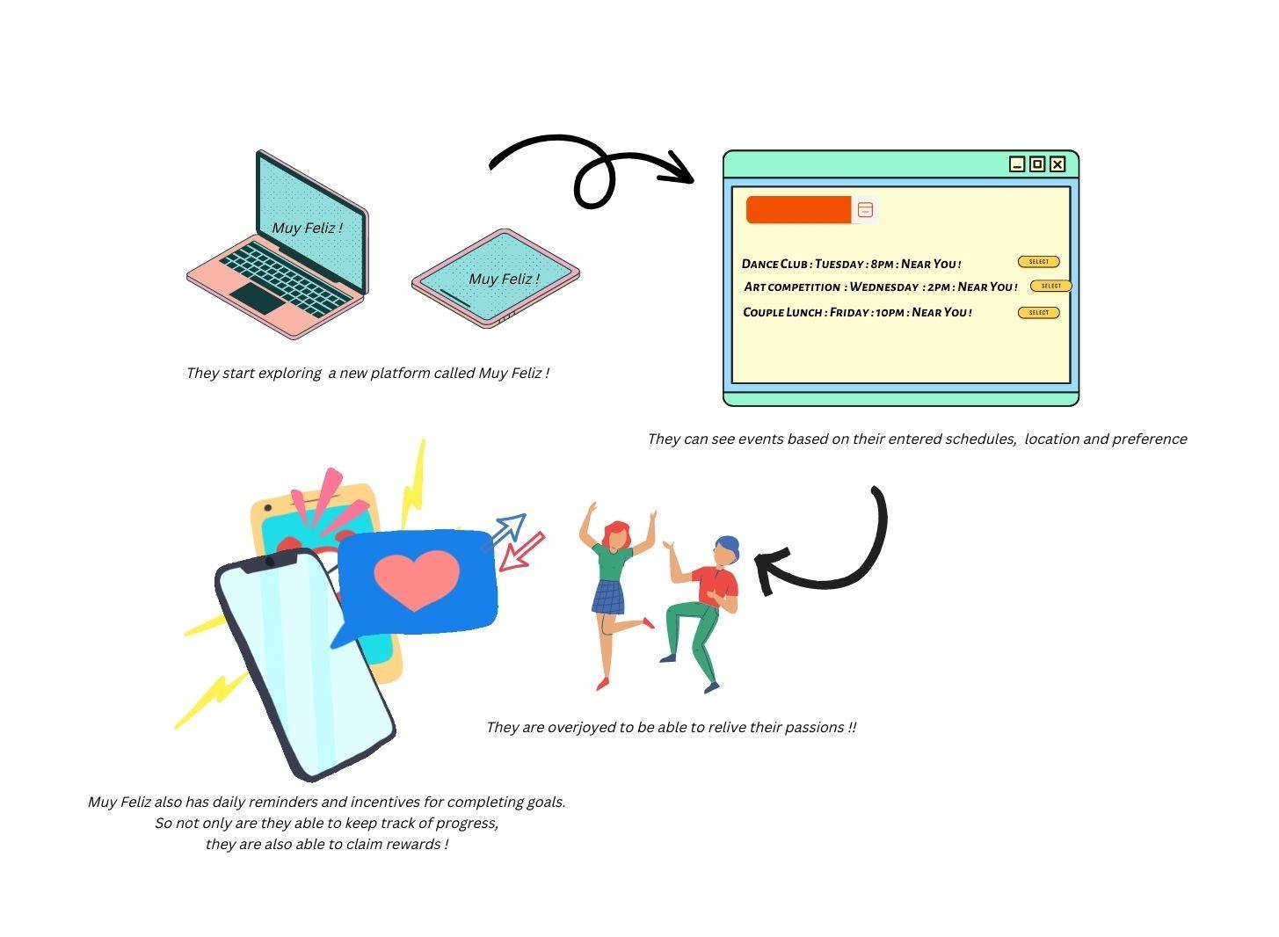

Slide 21
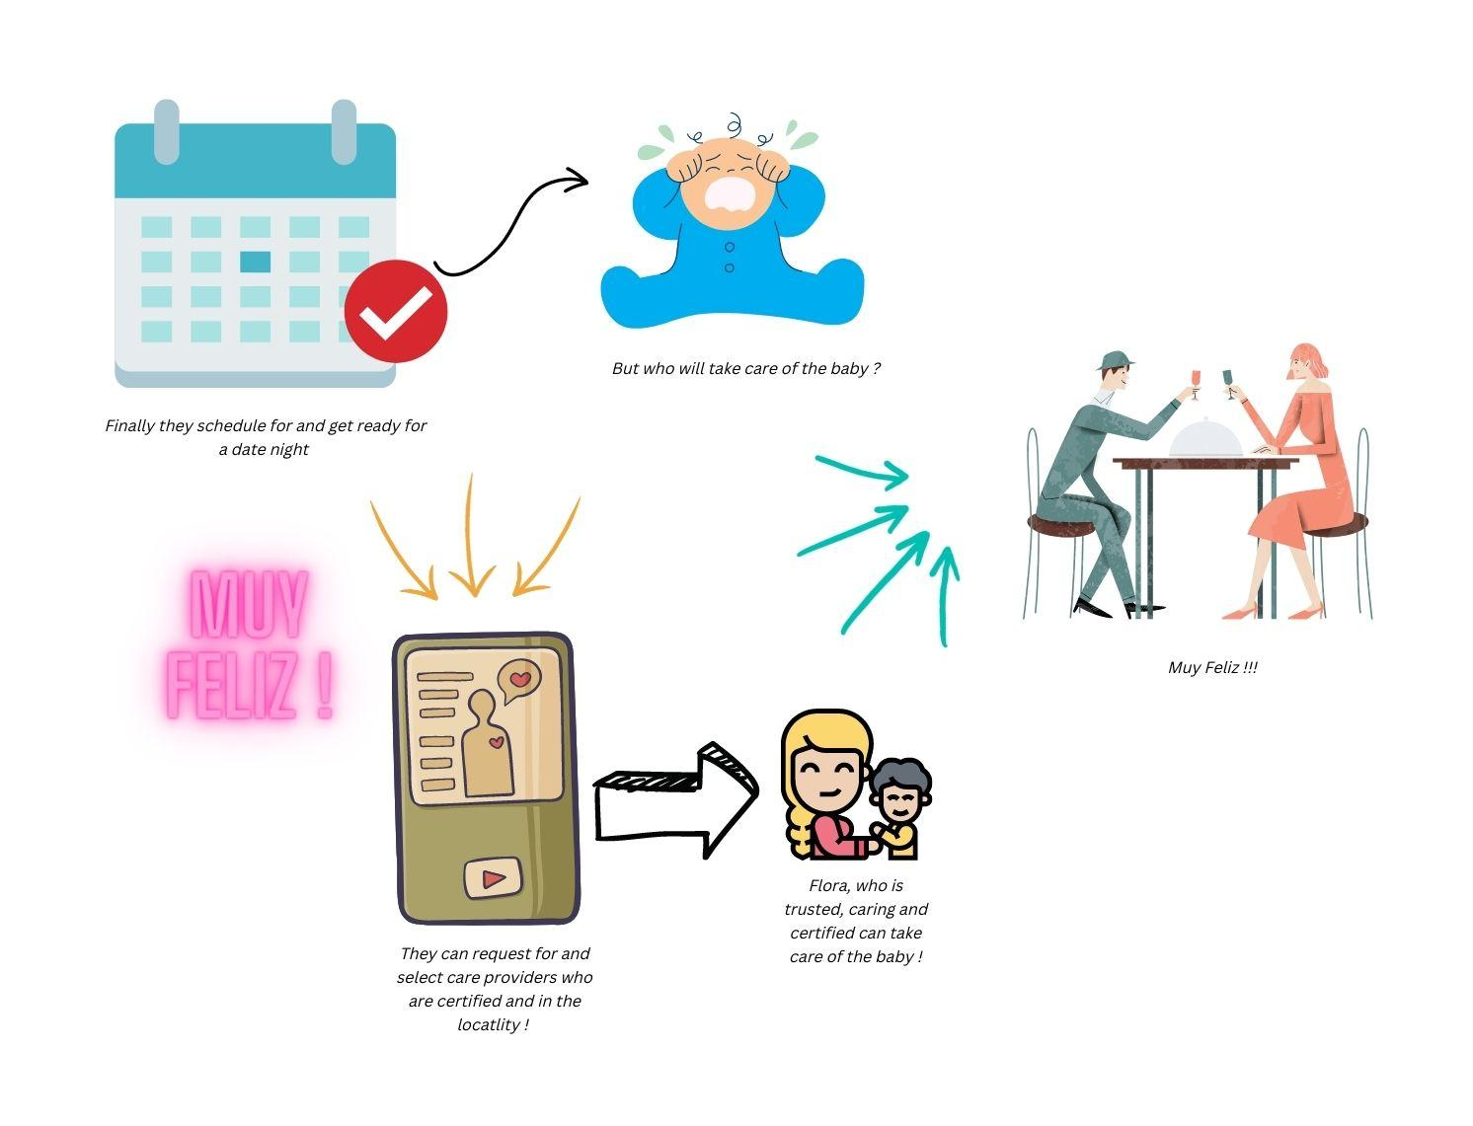

Slide 22
Storyboard : HMW provide means for parents to track daily goals and give incentives to do the same. (Best Solution)

Slide 23
Storyboard : HMW provide updated FAQs about allergies, home remedies and recipes to parents

Slide 24
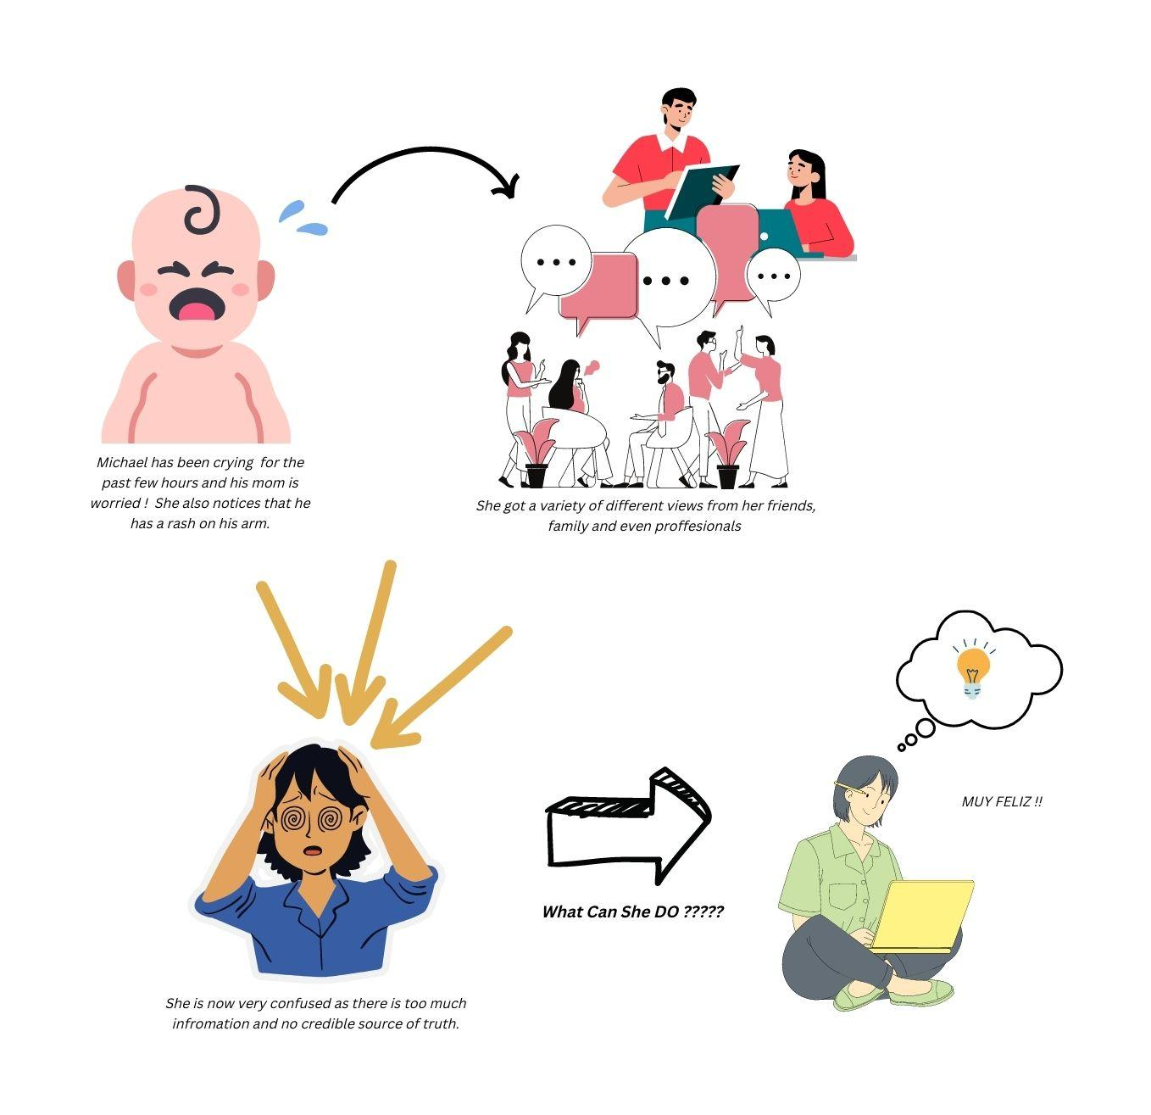

Slide 25
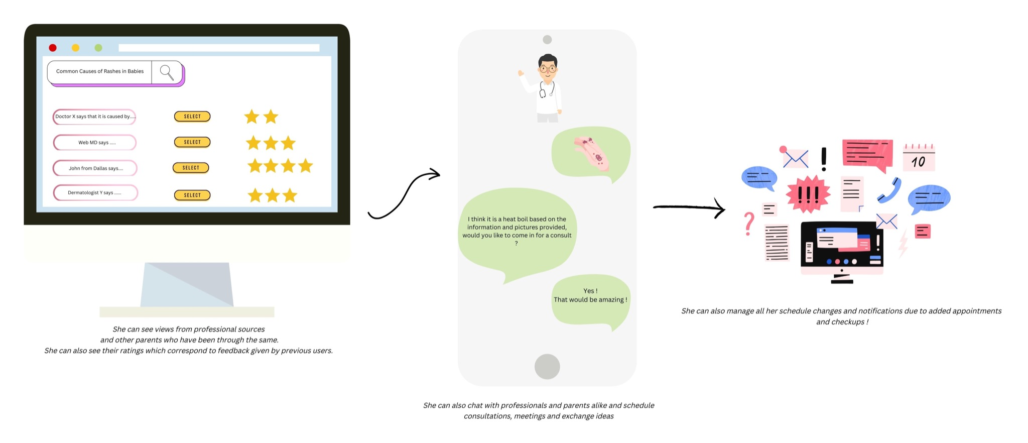

Slide 26
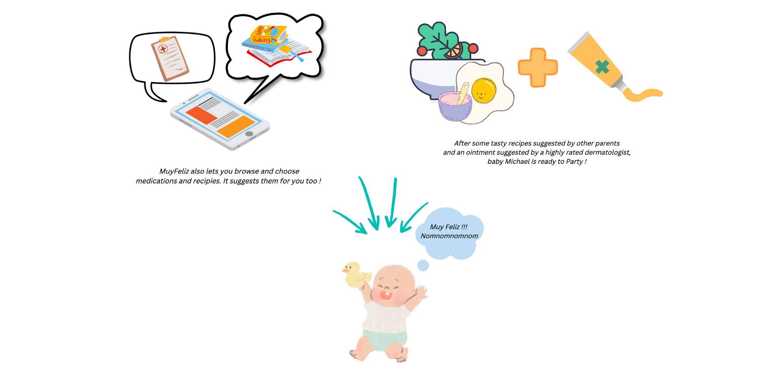

Slide 27
Storyboard : HMW provide updated FAQs about allergies, home remedies and recipes to parents

Slide 28
Storyboard : HWM support the mental Health and well being of parents

Slide 29
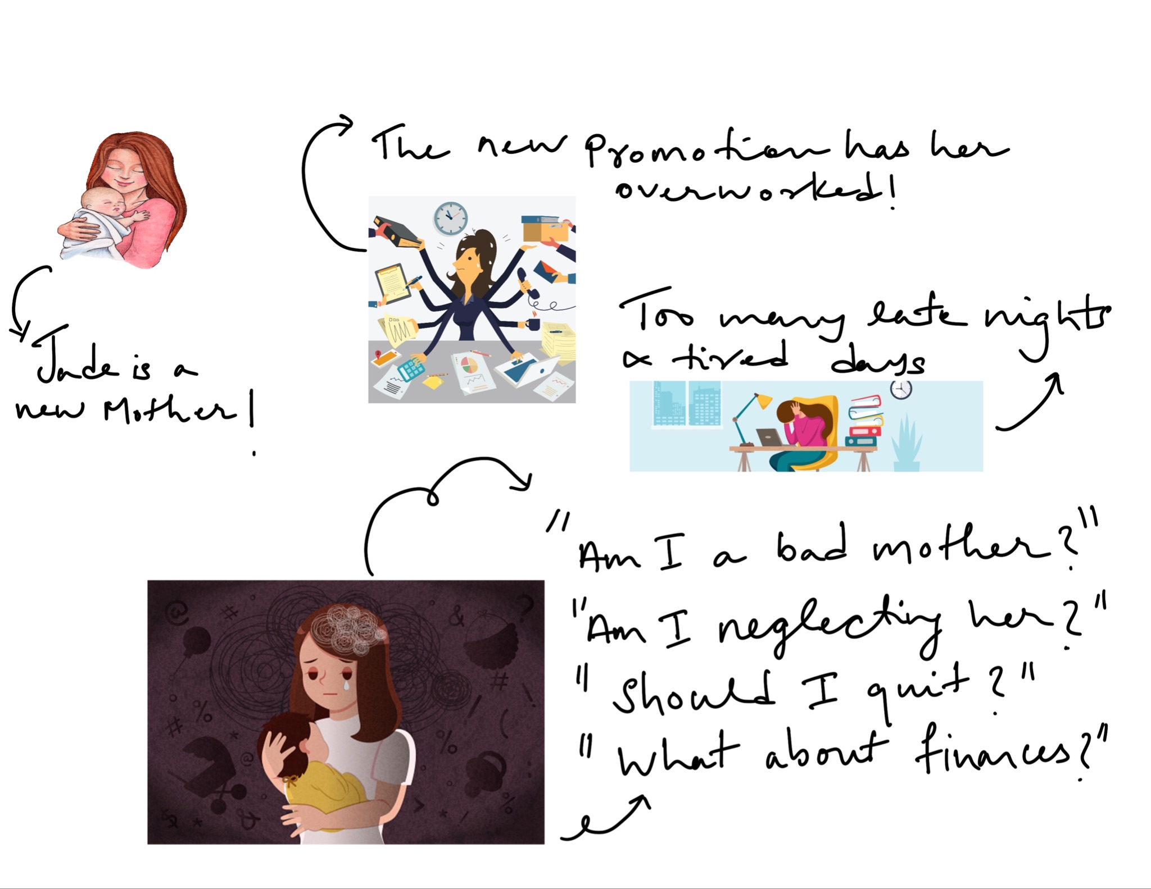

Slide 30
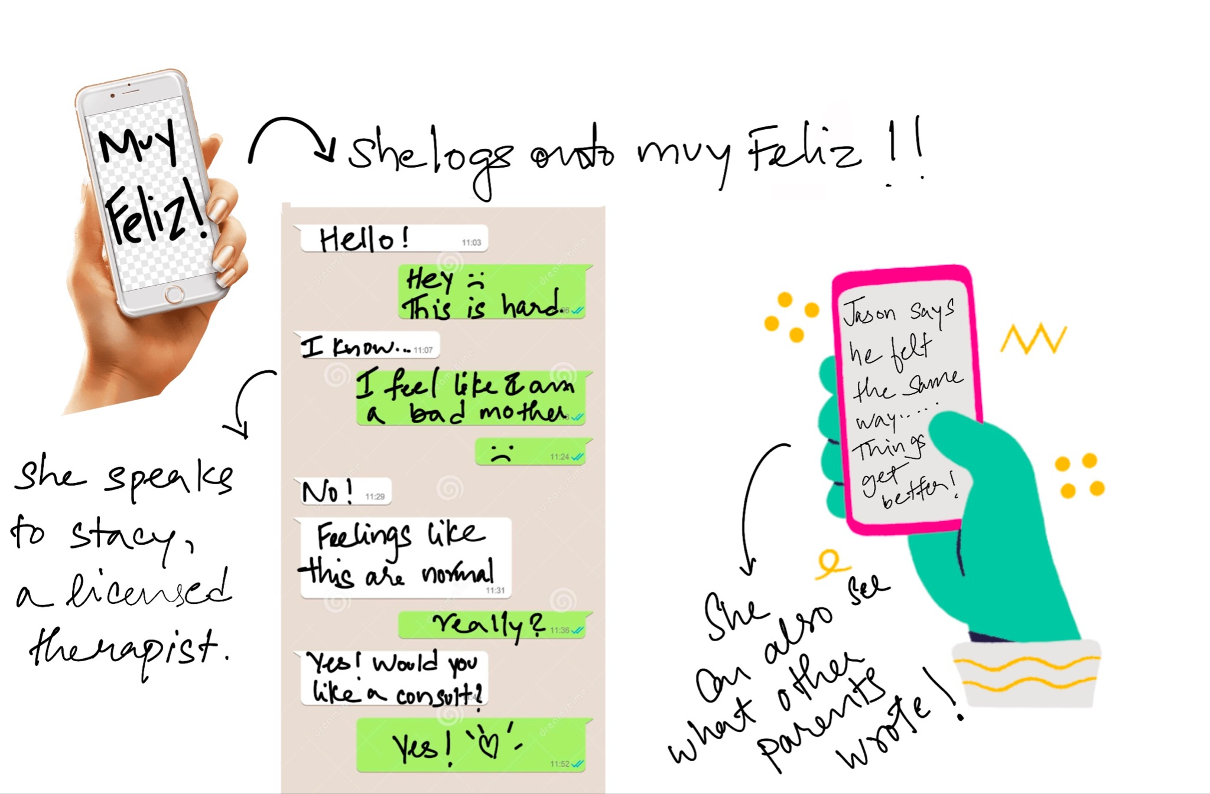

Slide 31
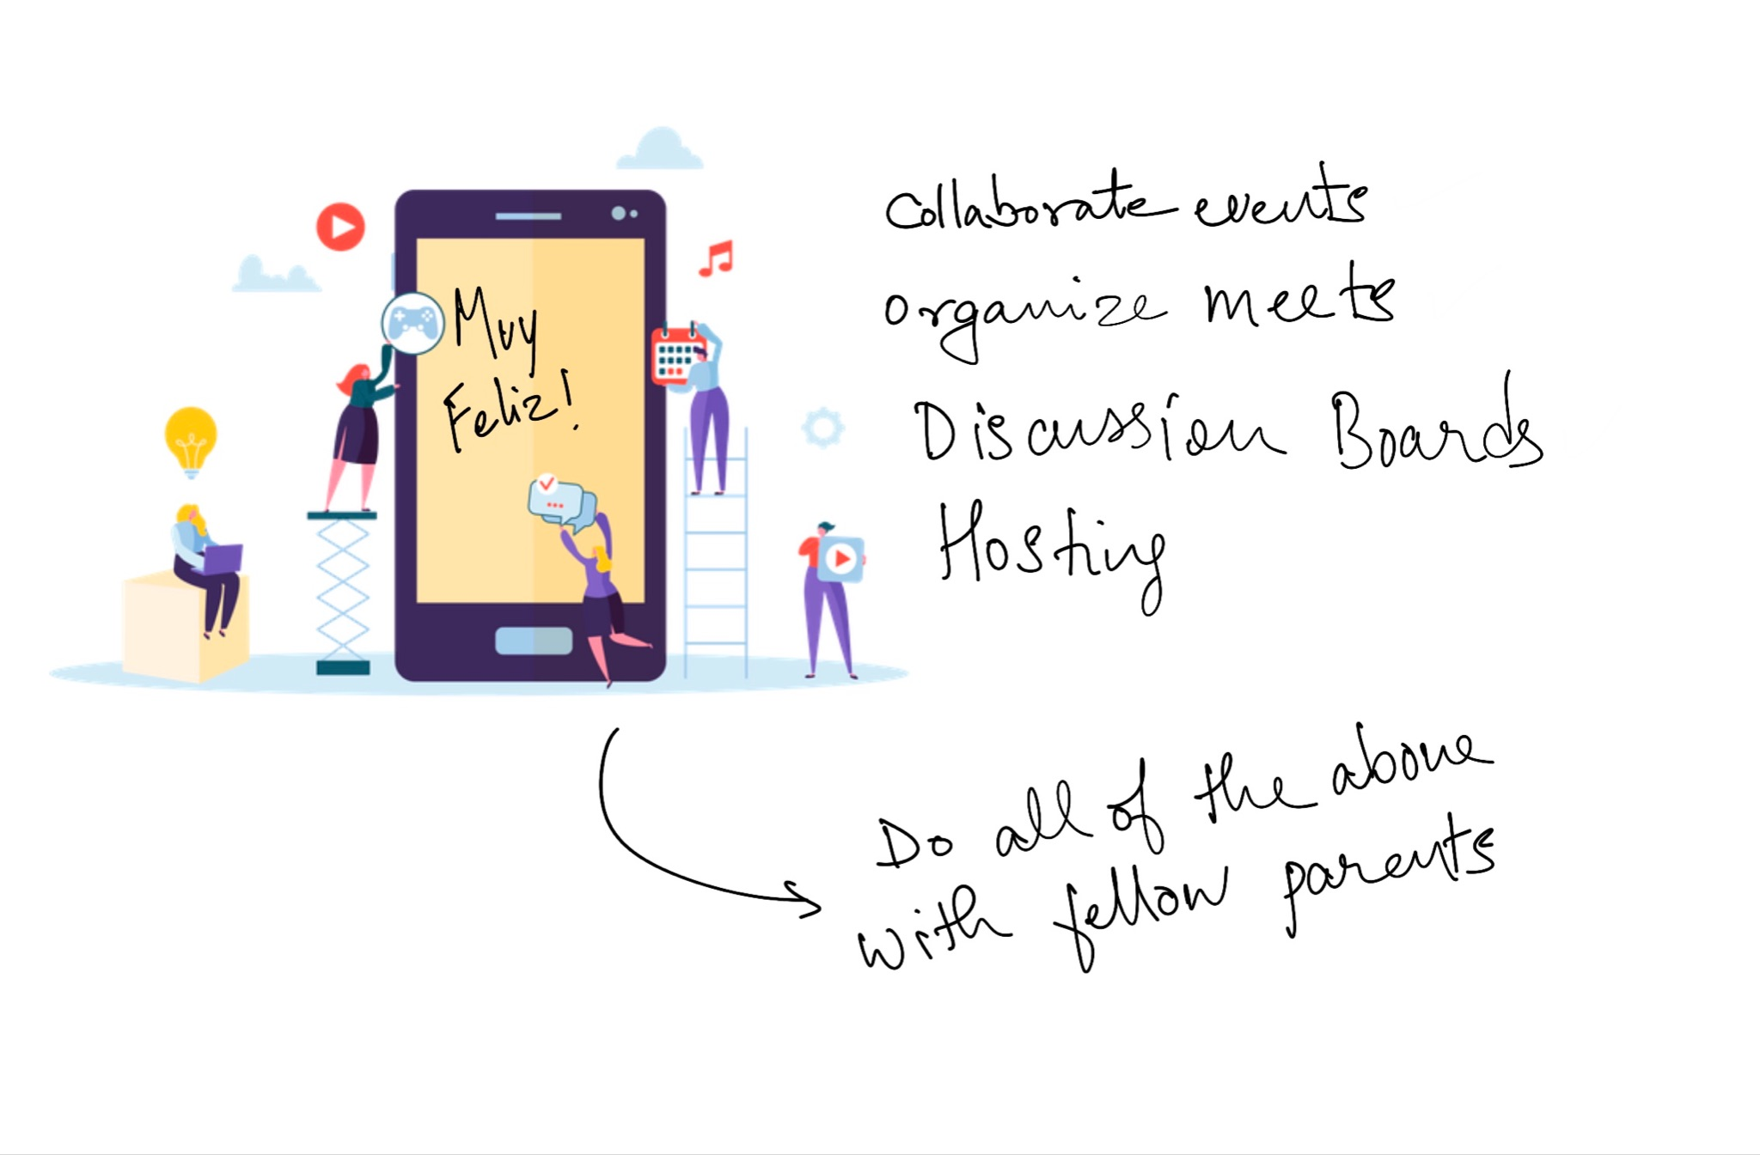

Slide 32
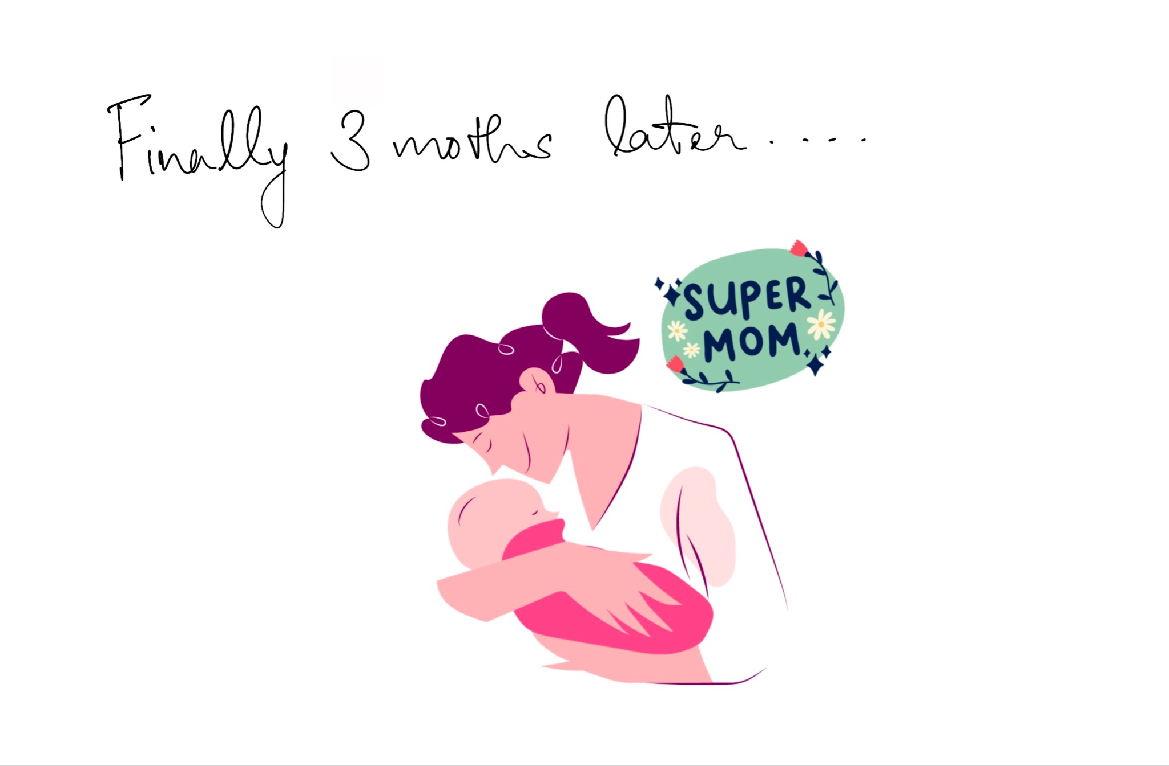

Slide 33
Storyboard : HMW support the mental Health and well being of parents

